Slide 1
AVL TREE

Slide 2
Properties
For every node, require heights of left & right children to differ by at most ±1
treat nil tree as height -1
each node stores its height
k-1
k

Slide 3
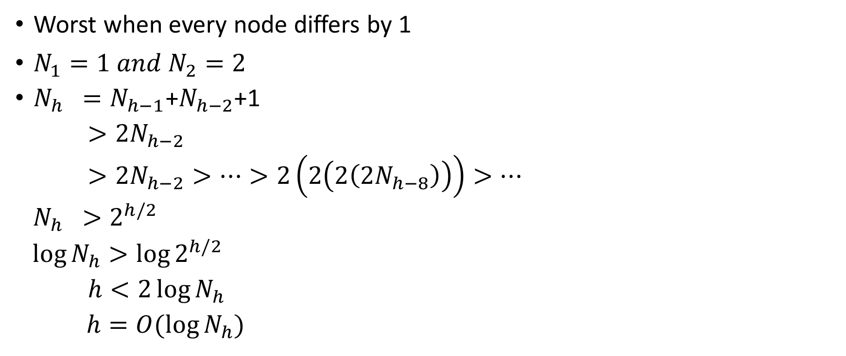
Balance
h
h-2
h-1
Worst when every node differs by 1
$N_{1}=1 and N_{2}=2$
$N_{h} =N_{h−1}$+$N_{h−2}$+1
$>2N_{h−2}$
$>2N_{h−2}>…>2\left(2\left(2\left(2N_{h−8}\right)\right)\right)>…$
$N_{h} >2^{h/2}$
$\log{N_{h}}>\log{2^{h/2}}$
$h<2\log{N_{h}}$
$h=O(\log{N_{h})}$

Slide 4

Alternatively
$N_{h} >F_{h}$
$F_{h}=\frac{φh}{\sqrt{5}}$ , $φ=\frac{1+\sqrt{5}}{2}≈1.618$(golden ratio)
$h≈\log_{φ}{n}≈1.440\log{n}$

Slide 5
Rotation
Single Rotation
left
right
Double rotation
left
right

Slide 6
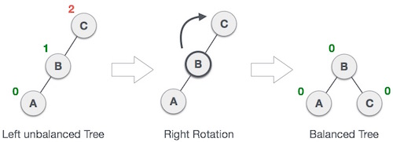
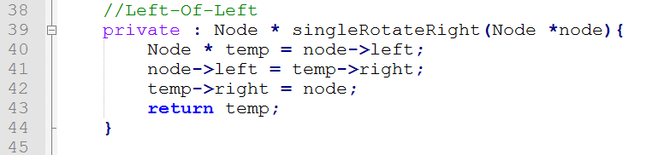
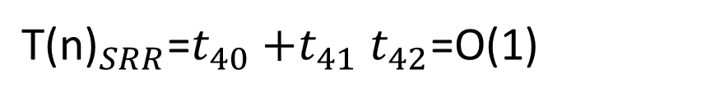
Single rotate right
${\text{T}\text{(}\text{n}\text{)}}_{SRR}$=$t_{40}{+t}_{41}t_{42}$=O(1)

Slide 7
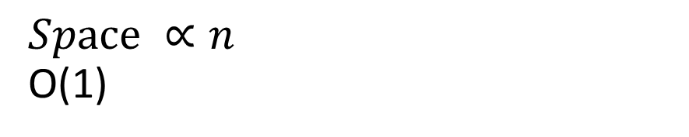
Single rotate right
memory
temp
F(n)
$$Space ∝n$$
O(1)

Slide 8
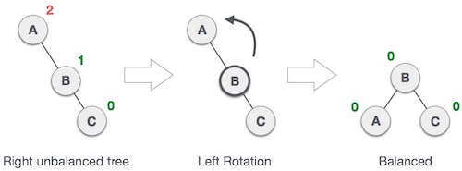
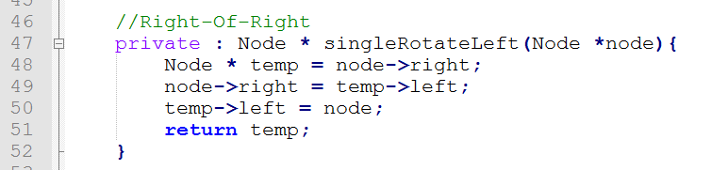
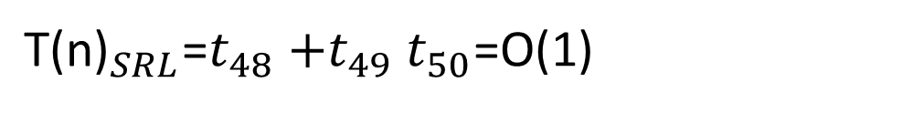
Single rotate left
${\text{T}\text{(}\text{n}\text{)}}_{SRL}$=$t_{48}{+t}_{49}t_{50}$=O(1)

Slide 9
Single rotate left
memory
temp
F(n)
$$Space ∝n$$
O(1)

Slide 10

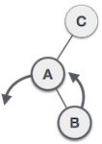
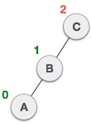
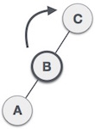
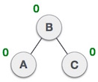
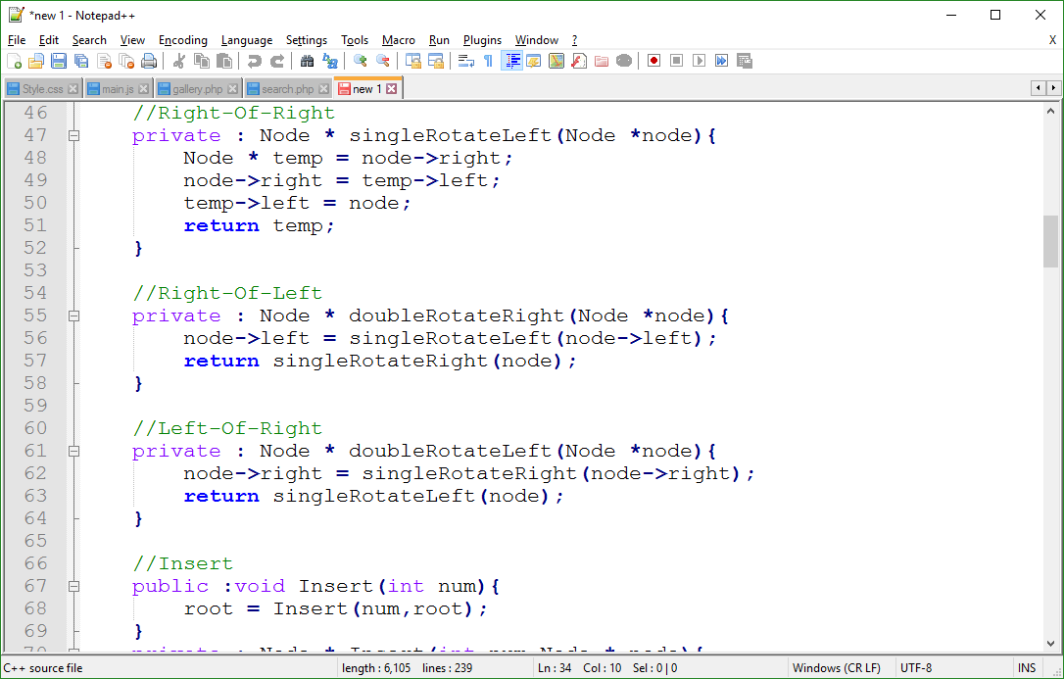
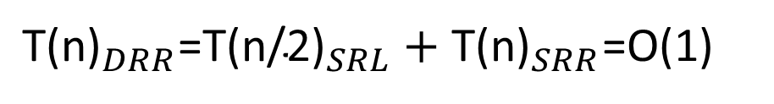
Double rotate right
${\text{T}\text{(}\text{n}\text{)}}_{DRR}$=${\text{T}\text{(}\text{n}\text{/}\text{2}\text{)}}_{SRL}+{\text{T}\text{(}\text{n}\text{)}}_{SRR}$=O(1)

Slide 11
Double rotate right
memory
SRR(n)
SRL(n/2)
DRR(n)
$$Space ∝n$$
O(1)

Slide 12

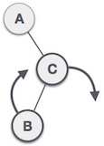
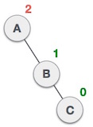
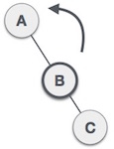
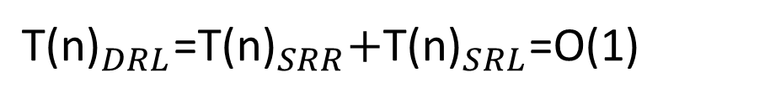
Double rotate left
${\text{T}\text{(}\text{n}\text{)}}_{DRL}$=${{\text{T}\text{(}\text{n}\text{)}}_{SRR}\text{+}\text{T}\text{(}\text{n}\text{)}}_{SRL}$=O(1)

Slide 13
Double rotate left
memory
SRL(n)
SRR(n/2)
DRL(n)
$$Space ∝n$$
O(1)

Slide 14
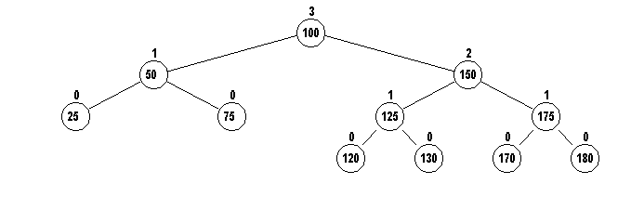
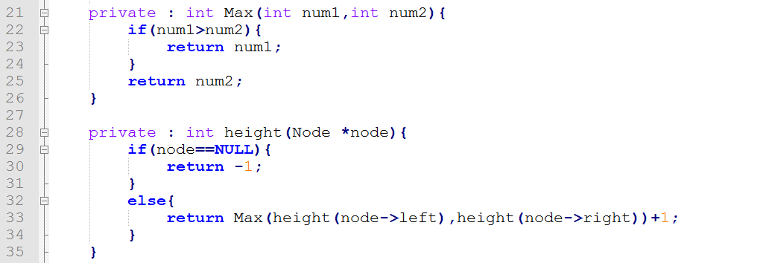
Height

Slide 15
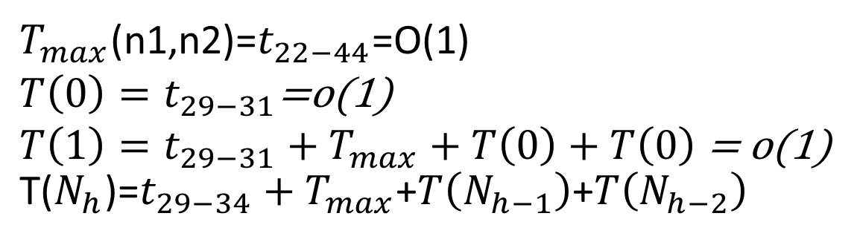
Height
$T_{max}$(n1,n2)=$t_{22−44}$=O(1)
$T\left(0\right)=t_{29−31}$=o(1)
$T\left(1\right)=t_{29−31}+T_{max}+T\left(0\right)+T\left(0\right)$ = o(1)
$\text{T}\text{(}N_{h}\text{)}$=$t_{29−34}+T_{max}$+$T\left(N_{h−1}\right)$+$T\left(N_{h−2}\right)$

Slide 16
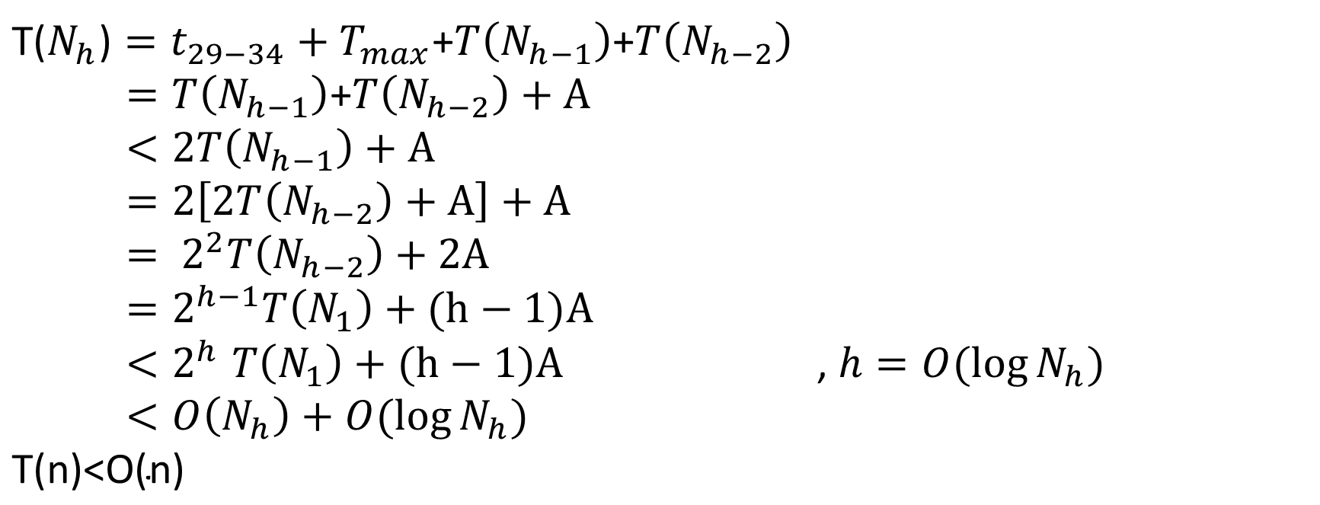
$\text{T}\text{(}N_{h}\text{)}=t_{29−34}+T_{max}$+$T\left(N_{h−1}\right)$+$T\left(N_{h−2}\right)$
$=T\left(N_{h−1}\right)$+$T\left(N_{h−2}\right)+A$
$<2T\left(N_{h−1}\right)+A$
$=2\left[2T\left(N_{h−2}\right)+A\right]+A$
$= 2^{2}T\left(N_{h−2}\right)+2A$
$=2^{h−1}T\left(N_{1}\right)+(h−1)A$
${<2}^{h}T\left(N_{1}\right)+(h−1)A$ , $h=O(\log{N_{h})}$
$<O\left(N_{h}\right)+$ $O(\log{N_{h})}$
$$\text{T}\text{(}\text{n}\text{)}\text{<}\text{O}\text{(}\text{n}\text{)}$$

Slide 17
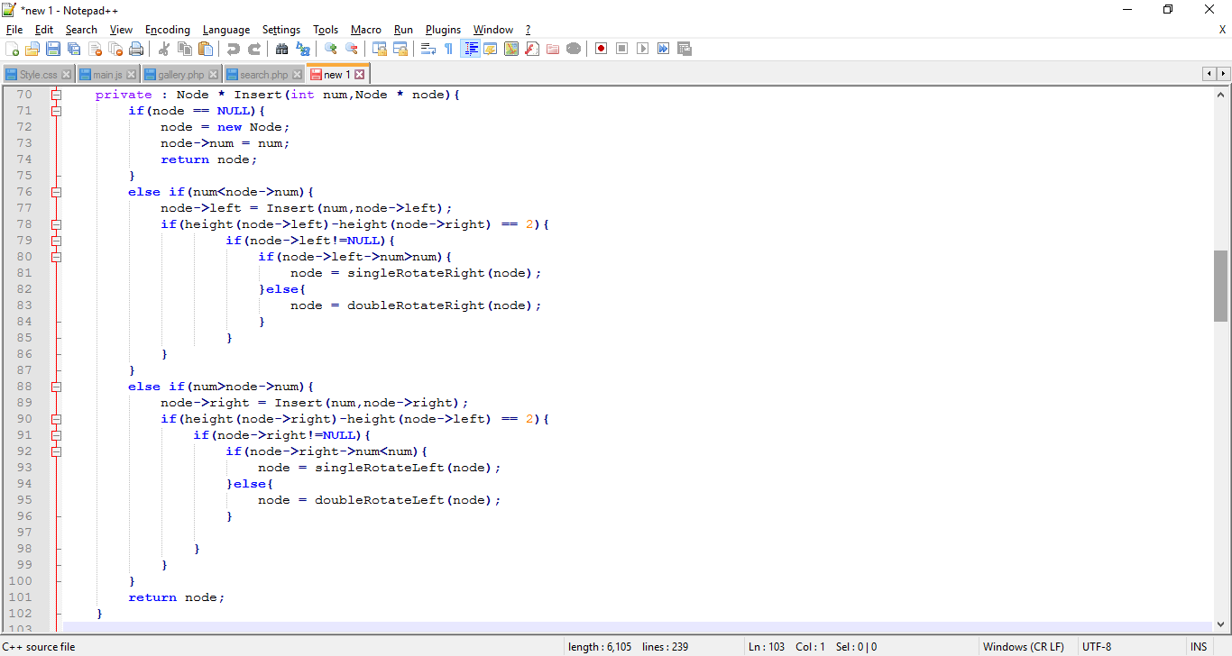
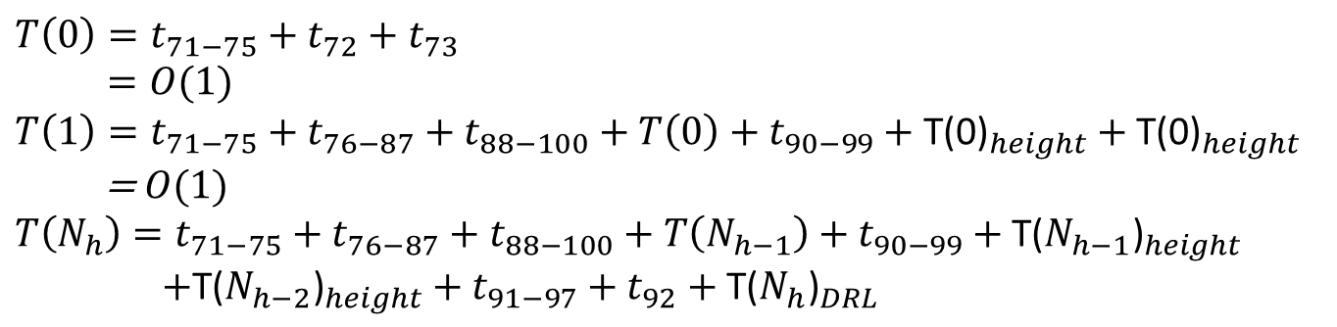
Insert
$$T\left(0\right)=t_{71−75}+t_{72}+t_{73}$$
$=O(1)$
$$T\left(1\right)=t_{71−75}+t_{76−87}+t_{88−100}+T\left(0\right)+t_{90−99}+{\text{T}\text{(0)}}_{height}+{\text{T}\text{(0)}}_{height}$$
=$O(1)$
$$T\left(N_{h}\right)=t_{71−75}+t_{76−87}+t_{88−100}+T\left(N_{h−1}\right)+t_{90−99}+{\text{T}\text{(}N_{h−1}\text{)}}_{height}$$
$+{\text{T}\text{(}N_{h−2}\text{)}}_{height}+t_{91−97}+t_{92}+{\text{T}\text{(}N_{h}\text{)}}_{DRL}$

Slide 18
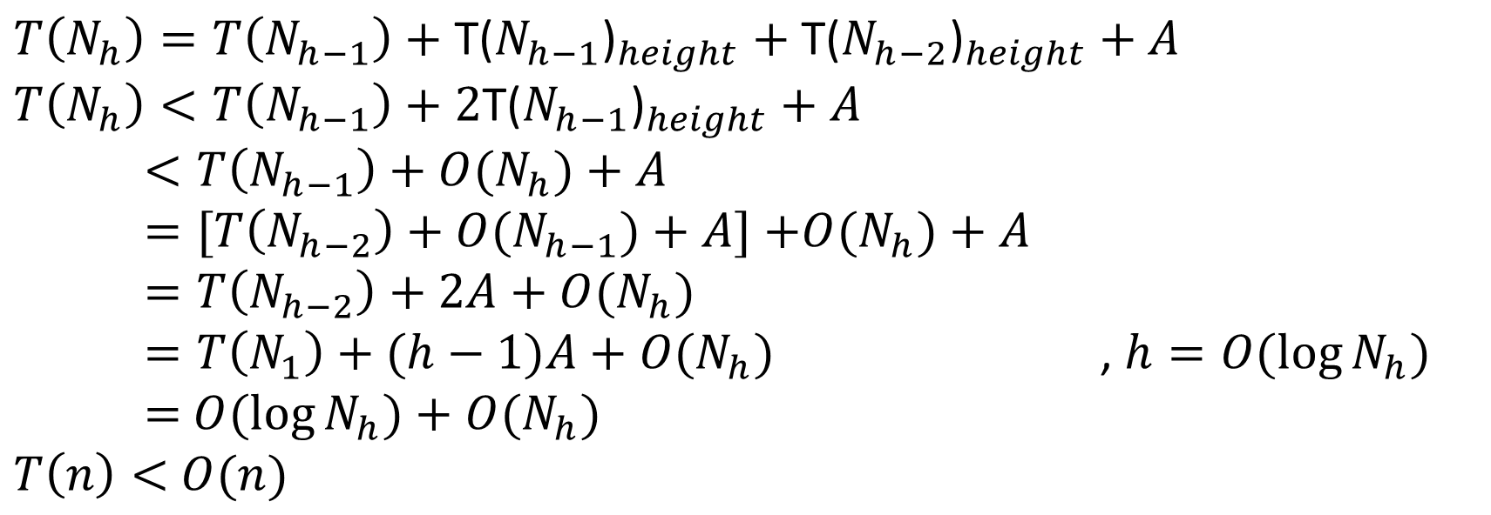
Insert
$$A=t_{71−75}+t_{76−87}+t_{88−100}+t_{90−99}+t_{91−97}+t_{92}{\text{+}\text{T}\text{(}N_{h}\text{)}}_{DRL}$$
$$T\left(N_{h}\right)=T\left(N_{h−1}\right)+{\text{T}\text{(}N_{h−1}\text{)}}_{height}+{\text{T}\text{(}N_{h−2}\text{)}}_{height}+A$$
$$T\left(N_{h}\right)<T\left(N_{h−1}\right)+2{\text{T}\text{(}N_{h−1}\text{)}}_{height}+A$$
$<T\left(N_{h−1}\right)+O(N_{h})+A$
$=[T\left(N_{h−2}\right)+O(N_{h−1})+A]$ $+O(N_{h})+A$
$=T\left(N_{h−2}\right)+2A+O(N_{h})$
$=T\left(N_{1}\right)+(h−1)A+O(N_{h})$ , $h=O(\log{N_{h})}$
$=$ $O(\log{N_{h})}+O(N_{h})$
$T\left(n\right)<$ $O(n)$

Slide 19
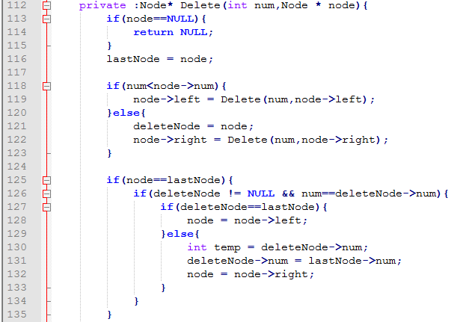
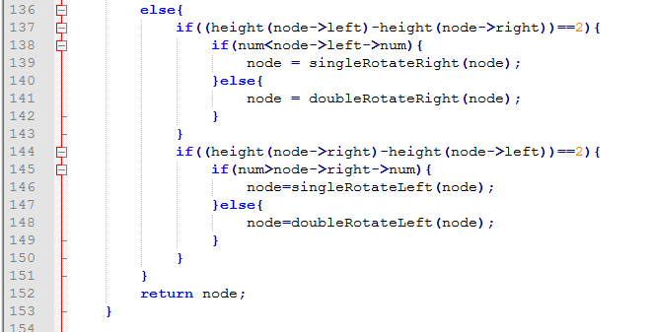
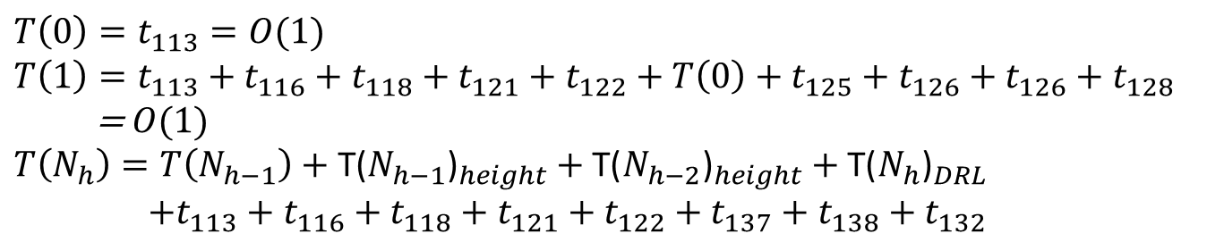
Delete
$$T\left(0\right)=t_{113}=O(1)$$
$$T\left(1\right)=t_{113}+t_{116}+t_{118}+t_{121}+t_{122}+T\left(0\right)+t_{125}+t_{126}+t_{126}+t_{128}$$
=$O(1)$
$$T\left(N_{h}\right)=T\left(N_{h−1}\right)+{\text{T}\text{(}N_{h−1}\text{)}}_{height}+{\text{T}\text{(}N_{h−2}\text{)}}_{height}+{\text{T}\text{(}N_{h}\text{)}}_{DRL}$$
$+t_{113}+t_{116}+t_{118}+t_{121}+t_{122}+t_{137}+t_{138}+t_{132}$

Slide 20
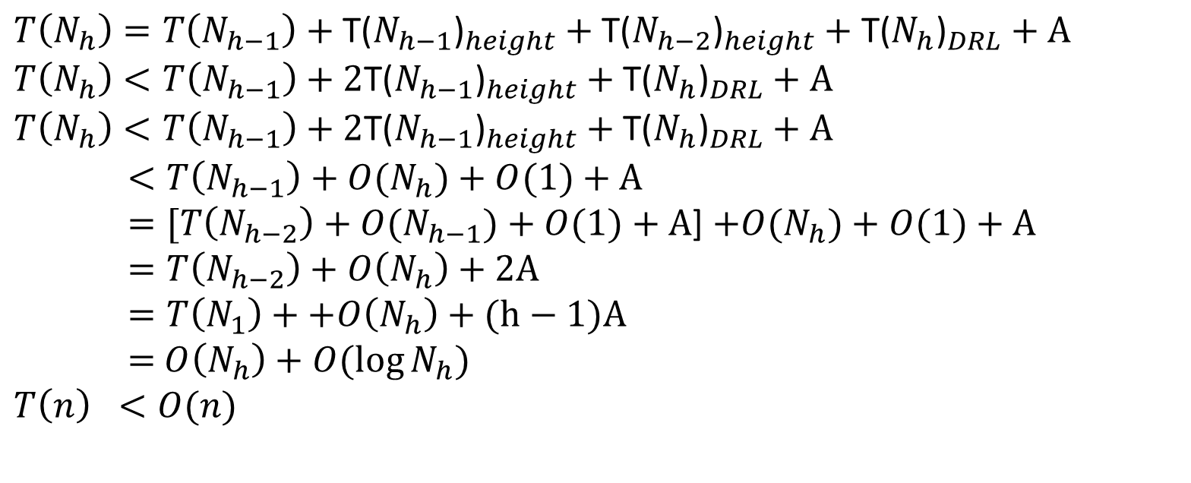
$$A=t_{113}+t_{116}+t_{118}+t_{121}+t_{122}+t_{137}+t_{138}+t_{132}$$
$$T\left(N_{h}\right)=T\left(N_{h−1}\right)+{\text{T}\text{(}N_{h−1}\text{)}}_{height}+{\text{T}\text{(}N_{h−2}\text{)}}_{height}+{\text{T}\text{(}N_{h}\text{)}}_{DRL}+A$$
$$T\left(N_{h}\right)<T\left(N_{h−1}\right)+{\text{2}\text{T}\text{(}N_{h−1}\text{)}}_{height}+{\text{T}\text{(}N_{h}\text{)}}_{DRL}+A$$
$$T\left(N_{h}\right)<T\left(N_{h−1}\right)+{\text{2}\text{T}\text{(}N_{h−1}\text{)}}_{height}+{\text{T}\text{(}N_{h}\text{)}}_{DRL}+A$$
$<T\left(N_{h−1}\right)+O(N_{h})+O(1)+A$
$=[T\left(N_{h−2}\right)+O(N_{h−1})+O(1)+A$] $+O(N_{h})+O(1)+A$
$=T\left(N_{h−2}\right)+O\left(N_{h}\right)+2A$
$=T\left(N_{1}\right)++O\left(N_{h}\right)+(h−1)A$
$=$ $O\left(N_{h}\right)+O(\log{N_{h})}$
$$T\left(n\right) <O(n)$$

Slide 21
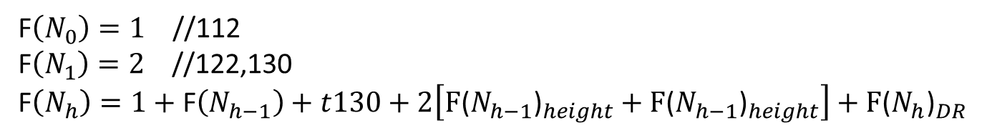
Delete
F$\left(N_{0}\right)=1$ //112
F$\left(N_{1}\right)=2$ //122,130
F$\left(N_{h}\right)=1+\text{F}\left(N_{h−1}\right)+t130+2\left[{\text{F}\text{(}N_{h−1}\text{)}}_{height}+{\text{F}\text{(}N_{h−1}\text{)}}_{height}\right]+{\text{F}\text{(}N_{h}\text{)}}_{DR}$

Slide 22
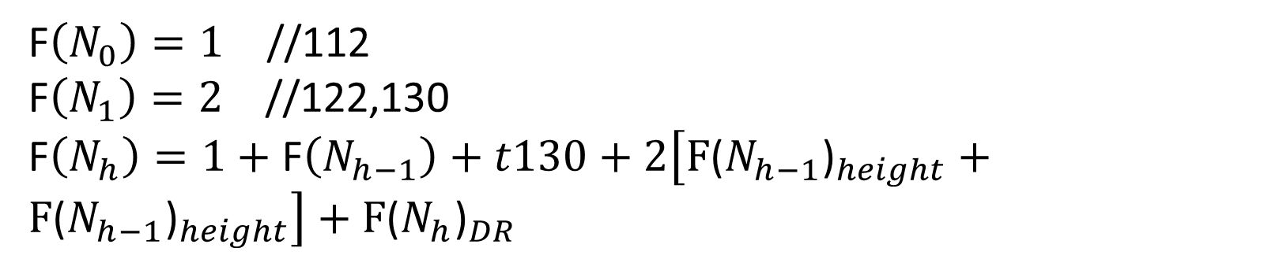
F$\left(N_{0}\right)=1$ //112
F$\left(N_{1}\right)=2$ //122,130
F$\left(N_{h}\right)=1+\text{F}\left(N_{h−1}\right)+t130+2\left[{\text{F}\text{(}N_{h−1}\text{)}}_{height}+{\text{F}\text{(}N_{h−1}\text{)}}_{height}\right]+{\text{F}\text{(}N_{h}\text{)}}_{DR}$

Slide 23
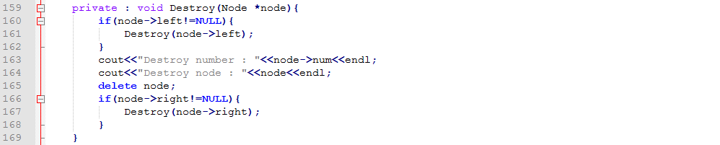
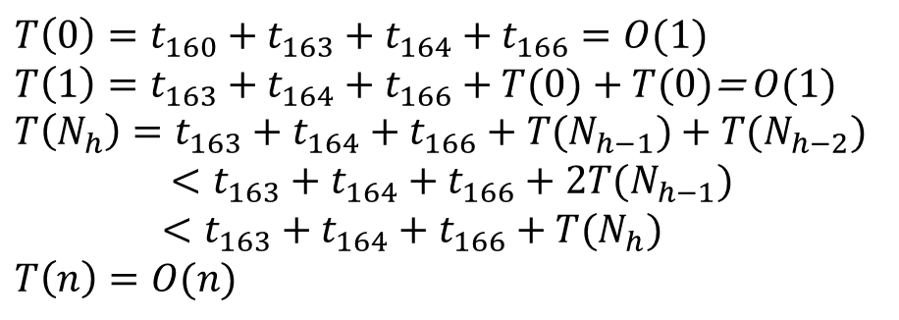
Destroy
$$T\left(0\right)=t_{160}+t_{163}+t_{164}+t_{166}=O(1)$$
$T\left(1\right)=t_{163}+t_{164}+t_{166}+T(0)+T(0)$=$O(1)$
$$T\left(N_{h}\right)=t_{163}+t_{164}+t_{166}+T(N_{h−1})+T(N_{h−2})$$
$<t_{163}+t_{164}+t_{166}+2T(N_{h−1})$
$<t_{163}+t_{164}+t_{166}+T(N_{h})$
$T\left(n\right)=O(n)$

Slide 24
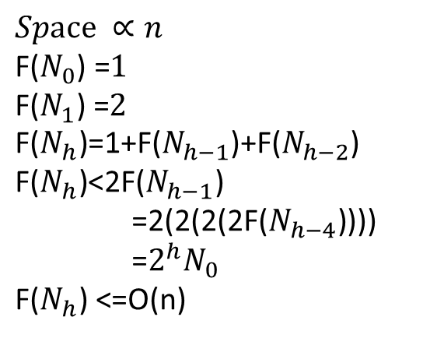
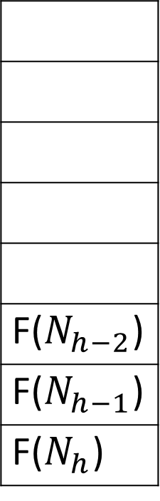
Destroy
F($N_{h−2}$)
F($N_{h−1}$)
F($N_{h}$)
$$Space ∝n$$
$$\text{F}\text{(}N_{0}\text{)} \text{=}1$$
$$\text{F}\text{(}N_{1}\text{)} \text{=}2$$
$$\text{F}\text{(}N_{h}\text{)}\text{=1+}\text{F}\text{(}N_{h−1}\text{)}\text{+}\text{F}\text{(}N_{h−2}\text{)}$$
$$\text{F}\text{(}N_{h}\text{)}\text{<2}\text{F}\text{(}N_{h−1}\text{)}$$
$\text{=}\text{2}\text{(2(2(2}\text{F}\text{(}N_{h−4}\text{)}$)))
$\text{=}2^{h}N_{0}$
$\text{F}\text{(}N_{h}\text{)} \text{<}$=O(n)

Slide 25
https://ocw.mit.edu/courses/electrical-engineering-and-computer-science/6-006-introduction-to-algorithms-fall-2011/lecture-videos/MIT6_006F11_lec06.pdf
https://courses.csail.mit.edu/6.006/spring11/rec/rec04.pdf
https://www.rose-hulman.edu/Users/faculty/young/CS-Classes/csse230/schedule/day9/LogHeightAVLTree.pdf
https://www.cs.cmu.edu/~fp/courses/15122-s11/lectures/18-avl.pdf
https://en.wikipedia.org/wiki/AVL_tree

